Slide 1

Learning Objective
I will identify prime numbers and composite numbers.
Enter quietly, please be ready with the following on your desk:
Whiteboard
Whiteboard marker
Exercise Book
Pencil, pen, ruler and red pen
Diary
Calculator
Device – charged or borrowed from Library before maths

Slide 2
Daily Review
CFU
How many answers will you get for LCM?
The Lowest Common Multiple (LCM) of two numbers is the lowest number that appears in all of the numbers’ times tables.
LCM of 3 and 5
LCM of 4 and 6
Write out the times tables of the first number.
3
6
9
12
15
5
10
15
4
8
12
16
20
24
6
12
18
24
Write out the times tables of the second number.
Highlight the first common number between the lists.
The LCM of 3 and 5 is 15.
The LCM of 4 and 6 is 12.
Clearly write out your answer.

Slide 3
Daily Review
CFU
What is a LCM?
The Lowest Common Multiple (LCM) of two numbers is the lowest number that appears in all of the numbers’ times tables.
Lowest Common Multiple of 9 and 6
Write out the times tables of the first number.
9
18
27
36
45
54
6
12
18
24
30
36
42
48
54
Write out the times tables of the second number.
The LCM of 9 and 6 is 18.
Highlight the first common number between the lists.
Clearly write out your answer.

Slide 4
Question
Which of the following is the LCM of 6 and 9?
A: 6
B: 9
C: 12
D: 18
E: 24
F: 54

Slide 5
Daily Review
CFU
Why is 1 always a common factor?
Just like common multiples, a common factor divides exactly into two or more numbers.
HCF of 25 and 40
HCF of 12 and 27
Write out the factors of the first number.
1
5
25
1
2
4
5
8
10
20
40
1
2
3
4
6
12
1
3
9
27
Write out the factors of the second number.
Highlight the common numbers between the lists.
Clearly write out your answer.
The HCF of 25 and 40 is 5.
The HCF of 12 and 27 is 3.

Slide 6
Skill Development
CFU
What is a HCF?
It is often useful to find the highest common factor (HCF) of a pair of numbers. This is also known as the greatest common devisor (GCD).
Write out the factors of the first number.
Highest Common Factor of 12 and 18
1
2
3
4
6
12
1
2
3
6
9
18
Write out the factors of the second number.
Highlight the largest number in common between the lists.
Clearly write out your answer.
The highest common factor of 12 and 18 is 6.

Slide 7
Question
Which of the following is the HCF of 20 and 24?
A: 1
B: 2
C: 3
D: 4
E: 6
F: 18

Slide 8

Learning Objective
CFU
What will we learn today?
CFU
I will identify prime numbers and composite numbers.
How will you know that you are successful?
Success Criteria
At the end of the lesson, I will be able to:
Apply the Sieve of Eratosthenes to identify prime numbers.
Identify the prime and composite numbers under 100

Slide 9
Concept Development
CFU
What is a composite number?
Composite number - A number that has more than two factors.
CFU
Prime number - A number that only has two factors (one and itself).
What is a prime number?
Example Number | Number of Factors | Composite or Prime
29 | 2: 1, 29 | Prime
30 | 8: 1, 2, 3, 5, 6, 10, 15, 30 | Composite

Slide 10
Skill Development
CFU
How do you decide if a number is composite or prime?
To find if a number is composite or prime:
6
20
Write out the factors of the number.
1, 2, 3, 6
1, 2, 4, 5, 10, 20
There are 4 factors,
There are 6 factors,
therefore 6 is a composite number.
therefore 20 is a composite number.
Count how many factors there are.
2 Factors = Prime
>2 Factors = Composite
23
21
1, 23
1, 3, 7, 21
There are 2 factors,
There are 4 factors,
therefore 23 is a prime number.
therefore 21 is a composite number.

Slide 11
Question
Which of the following are prime numbers?
A: 1
B: 2
C: 3
D: 4
E: 6
F: 10

Slide 12
Skill Development
CFU
How do you decide if a number is composite or prime?
To find if a number is composite or prime:
10
11
Write out the factors of the number.
1, 2, 5, 10
1, 11
There are 4 factors,
There are 2 factors,
therefore 10 is a composite number.
therefore 11 is a prime number.
Count how many factors there are.
2 Factors = Prime
>2 Factors = Composite
12
13
1, 2, 3, 4, 6, 12
1, 13
There are 6 factors,
There are 2 factors,
therefore 12 is a composite number.
therefore 13 is a composite number.

Slide 13
Question
Which of the following are prime numbers?
A: 12
B: 23
C: 30
D: 33
E: 61
F: 95

Slide 14
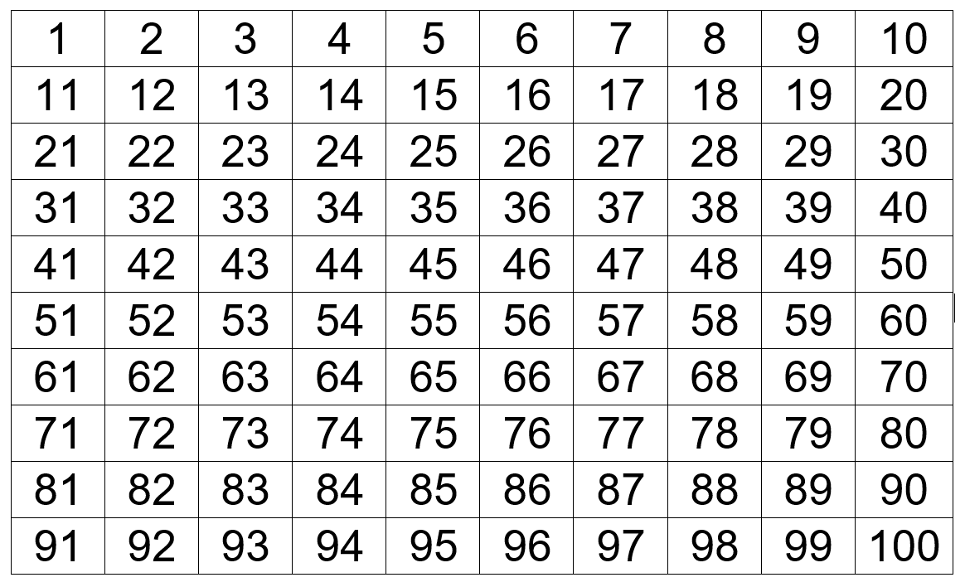
The Sieve of Eratosthenes

Slide 15
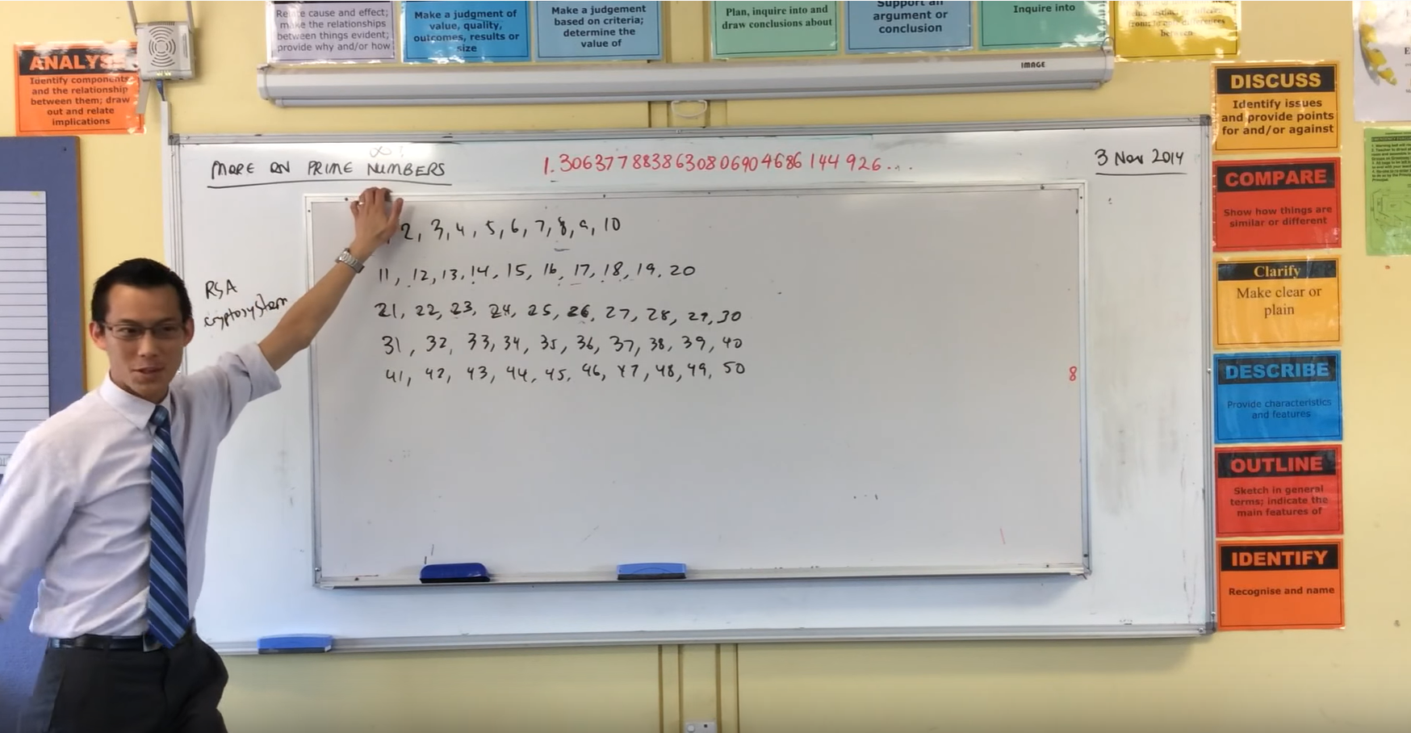
The Sieve of Eratosthenes

Slide 16
The Sieve of Eratosthenes
Step 1 Cross out the number 1.

Slide 17
The Sieve of Eratosthenes
Step 2 Go to the next number, which is 2, and highlight it. Then, cross out all of the other multiples of 2.

Slide 18
The Sieve of Eratosthenes
Step 3 Go to the next number that isn’t crossed out. This should be 3. Circle it. Then cross out all of the other multiples of 3.

Slide 19
The Sieve of Eratosthenes
Step 4 Go to the next number that isn’t crossed out, which should be 5. Circle it. Then cross out all of the other multiples of 5.

Slide 20
The Sieve of Eratosthenes
Step 5 Go to the next number that isn’t crossed out, which should be 7. Circle it. Then cross out all of the other multiples of 7.

Slide 21
The Sieve of Eratosthenes
Step 6 Circle any remaining numbers that haven’t been crossed out. All the circled numbers are prime numbers.

Slide 22

Skill Closure
What have we learnt today?
Lesson Objectives:
I will identify prime numbers and composite numbers.
  What is a prime number?
A number that only has two factors.

Slide 23


Independent Practice
Mathematics Page Layout
Open your textbooks to:
Chapter 2.2
Questions: 1-12

